Slide 1

Portfolio Project
Fiona Tolliday

Slide 2
Purpose and functionality
# Purpose:
-To build and deploy a website that will show my skills not only as a developer using HTML and CSS, but also to showcase my educational and professional skills. The website will allow users to see my personality, but also be able to click through to my github and linkedin accounts to view further information relating to my work and career. <br>
# Functionality / features:
- This website has four pages of content which can be toggled via the nav bar.
- The home page is responsive for mobile with the use of media queries. Media queries enable to quote to move between the header image and the main content section. A media query also enables the nav bar to move from the centre main area up to the top right below the header image.
- The home page quote features "lightening" animation, however this is only functional using Firefox.
- Each page contains logo click-throughs direct to my linked profile and github account set in the footer.
Content includes about-me info, work experience and qualifications as well as a submittable email form for anyone seeking to contact me.

Slide 3
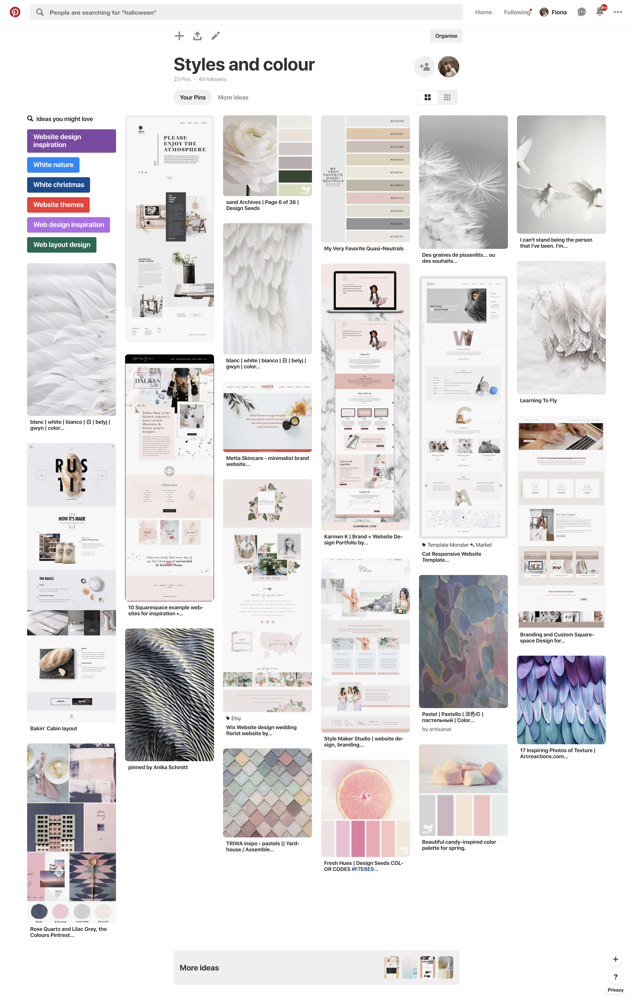
Design Process
# Design process:
- Pinterest was my inspiration of this page.
- I like crisp, clean and calming colours, so spent time looking at white and feathers.
- The feathers add an element of texture, but softness which complements the calming colours.
- The colours selected were chalky colours that are somewhat muted, in line with the calming theme.

Slide 4
Challenges
# Challenges:
Getting the pages to be responsive for mobile
Using grid
Using HTML and CSS with little knowledge or understanding

